Slide 1
Data-analysis of Al-reference samples
From SilverLIBS
(prototype with Litron-laser and IBSEN spectrometer)

Slide 2
Samples
Elements of interest:
Si, Fe, Mg, Zn, Cu, Mn
Ref. element:
Al

Slide 3
Samples

Slide 4
Steps
Identify peaks
Since we used gated spectrometer ionic lines are not expected
Sort spectra to use
Sort on Al-peak: 308,24
Offset (zero-level): 100
Remove baseline and
Calibration curves:
Minimum intensity 1000 (and saturation 60000)
Minumim intensity 5000 (and saturation 60000)

Slide 5
Chosen peaks (chosen=1, possible other=0)
Si | Mg II | Zn | Zn | Mn | Mn | Mn | Mn | Fe | Fe | Fe | Fe | Fe | Fe | Fe | Cu | Cu | Al | Al | Al, | Al,
1 | 1 | 0 | 1 | 1 | 0 | 0 | 0 | 0 | 1 | 0 | 0 | 0 | 0 | 0 | 1 | 0 | 1 | 0 | 0 | 0
--------- | --------- | ---- | ---- | --------- | --------- | --------- | ---- | --------- | --------- | --------- | ---- | --------- | --------- |  | --------- | --------- | --------- | --------- | --------- | ---------
288,18 | 383,82 | 330,24 | 334,50 | 403,10 | 403,30 | 403,40 | 404,10 | 257,57 | 357,00 | 372,00 | 373,43 | 373,69 | 404,58 | 427,10 | 324,73 | 327,37 | 308,24 | 309,31 | 394,41 | 396,15

Slide 6
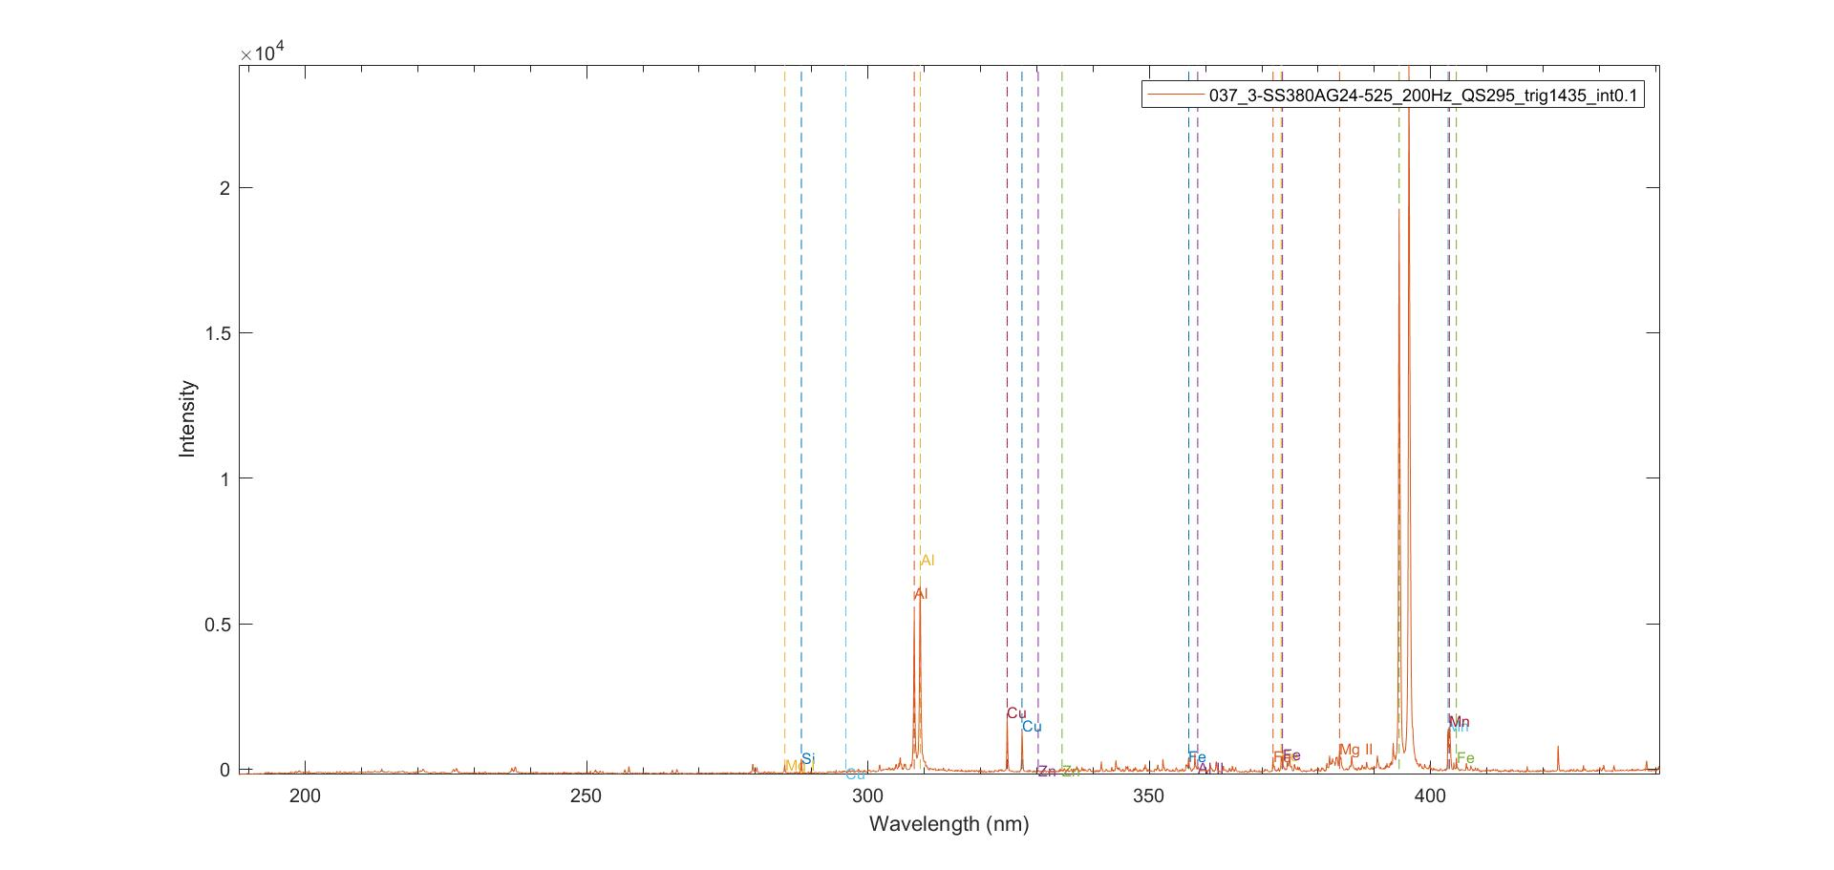
Example, identification of peaks

Slide 7
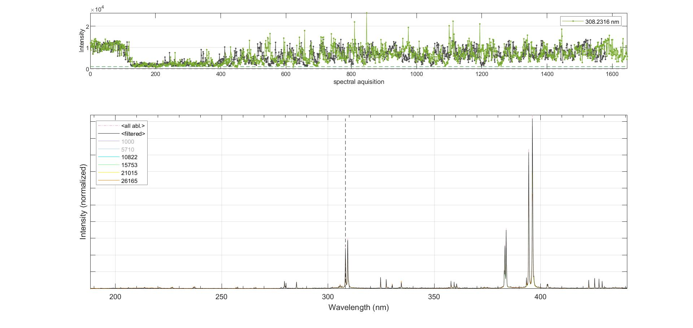
Example, sorting: 038 - Gränges al 6958-v-336

Slide 8
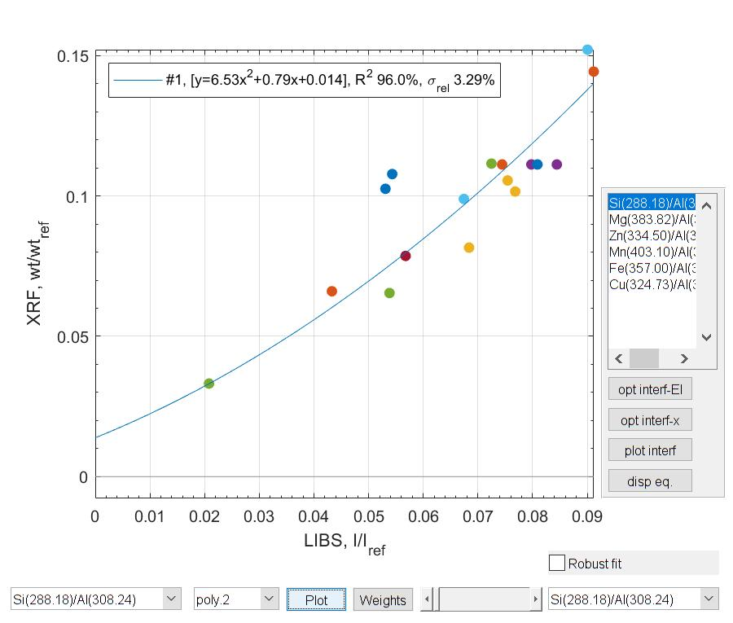
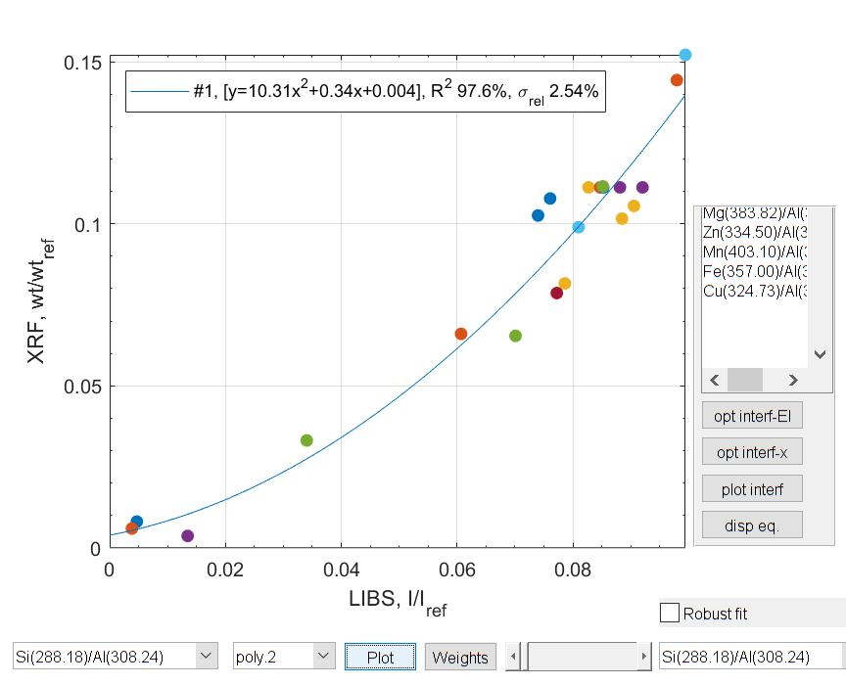
Si 288,18 / Al 308,24
Reference intensity: >1000 cts
Reference intensity: >5000 cts

Slide 9
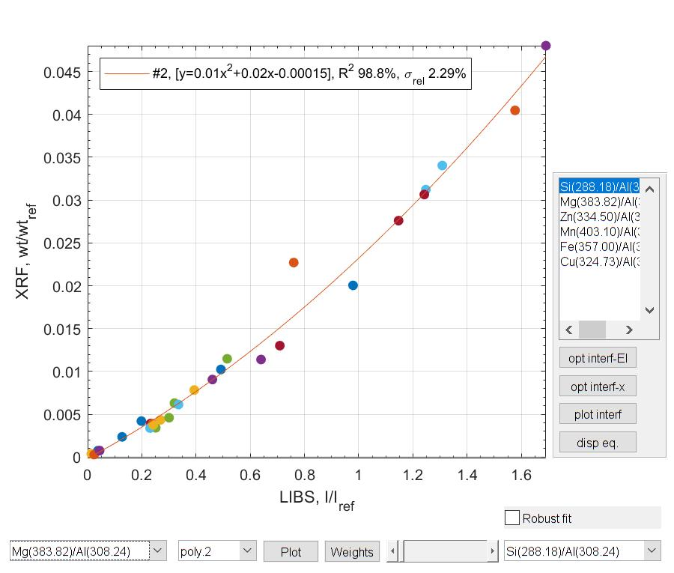
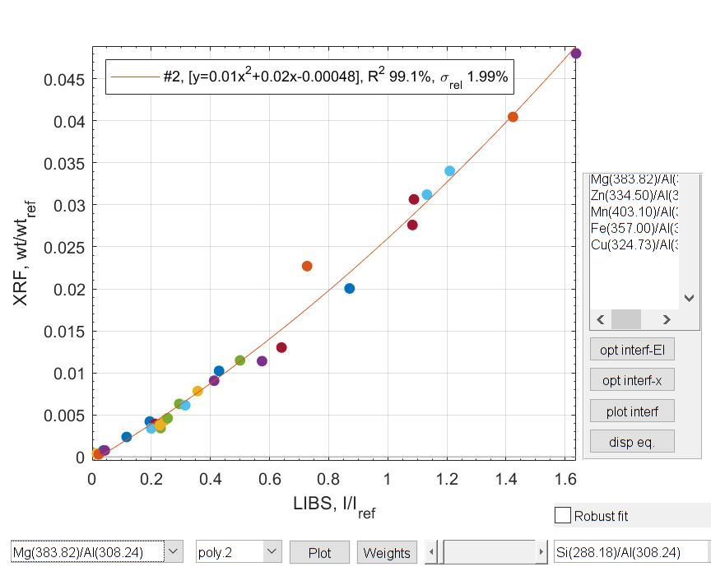
Mg 383,82 / Al 308,24
Reference intensity: >1000 cts
Reference intensity: >5000 cts

Slide 10
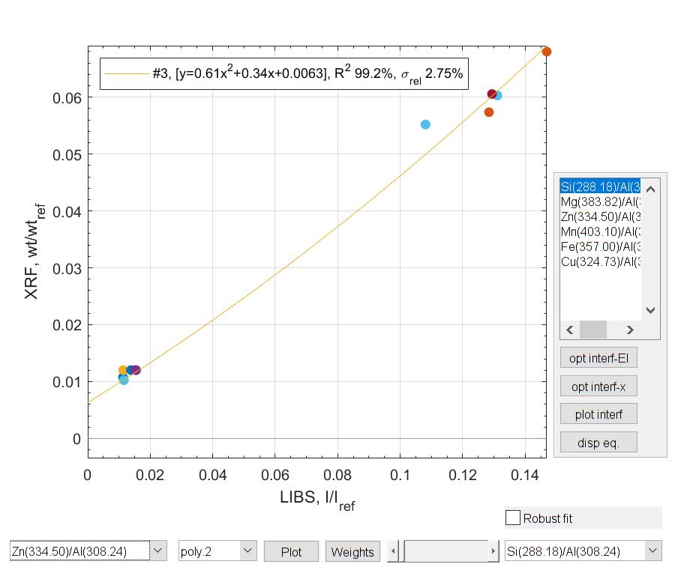
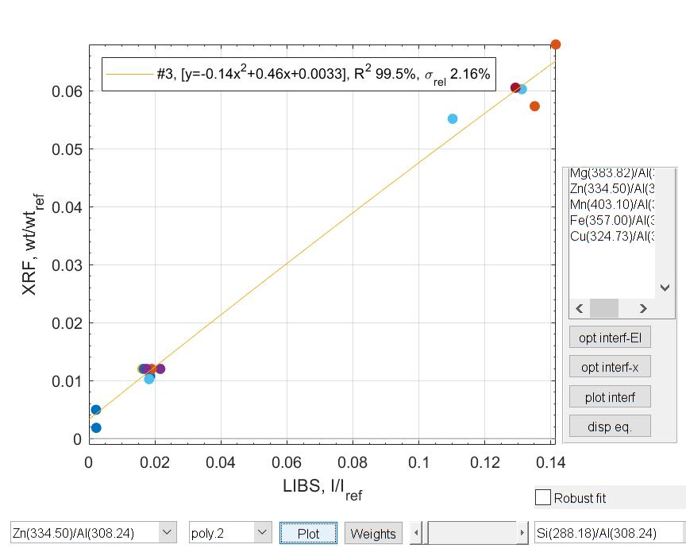
Zn 334,50 / Al 308,24
Reference intensity: >1000 cts
Reference intensity: >5000 cts

Slide 11
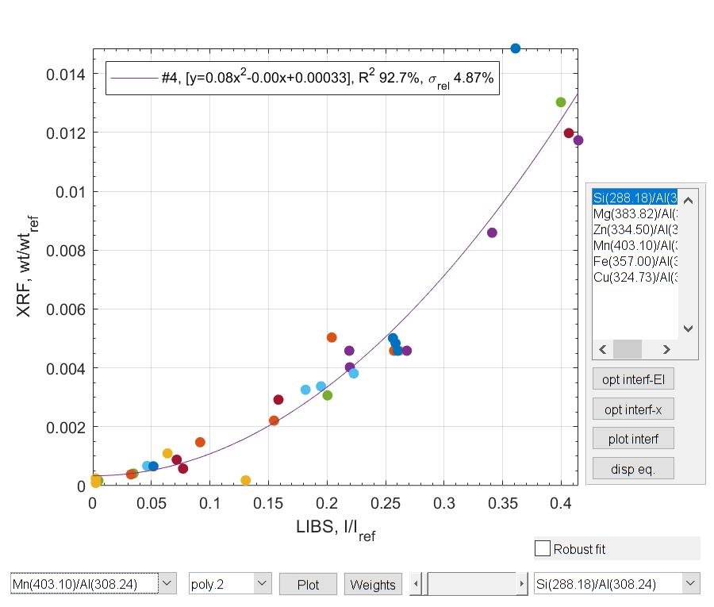
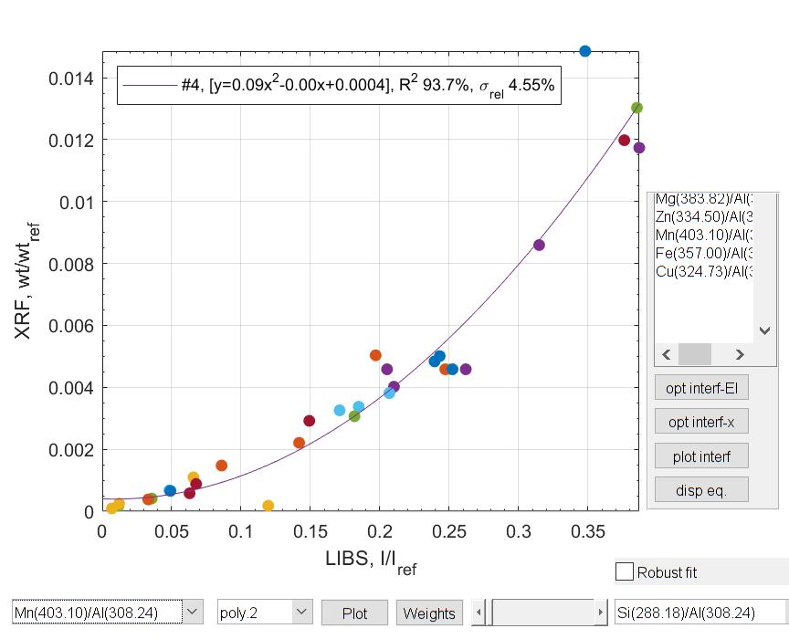
Mn 403,10 / Al 308,24
Reference intensity: >1000 cts
Reference intensity: >5000 cts

Slide 12
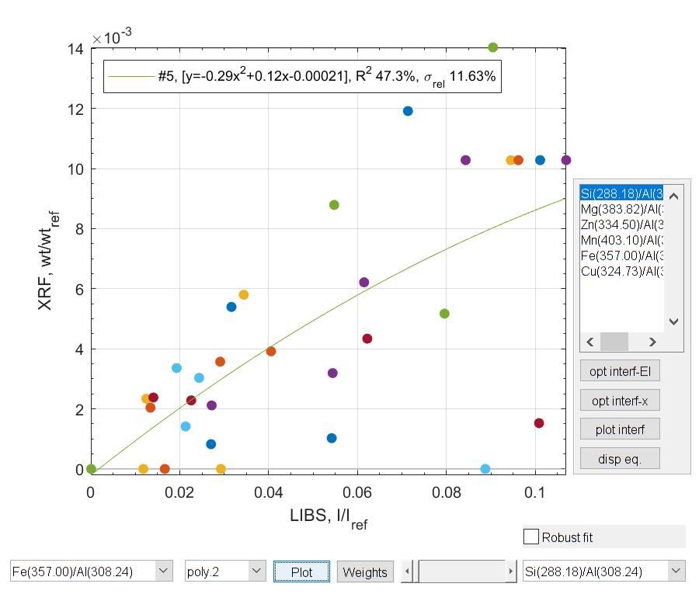
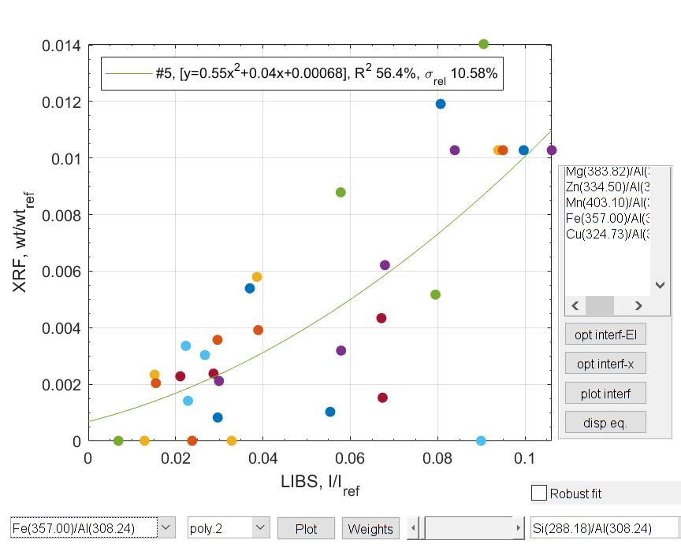
Fe 357,0 / Al 308,24
Reference intensity: >1000 cts
Reference intensity: >5000 cts

Slide 13
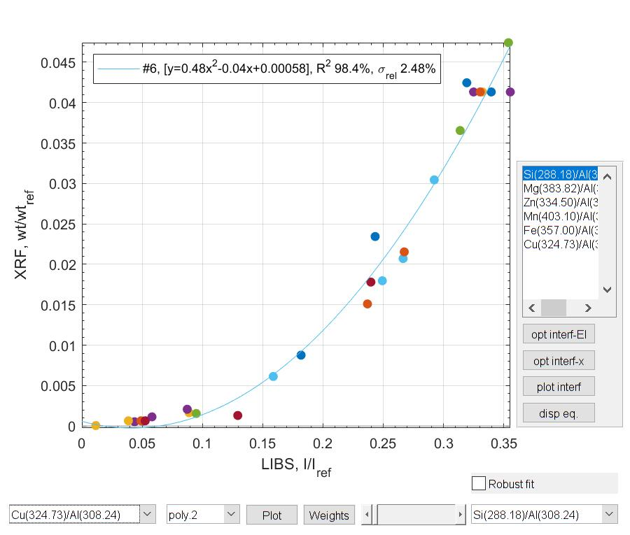
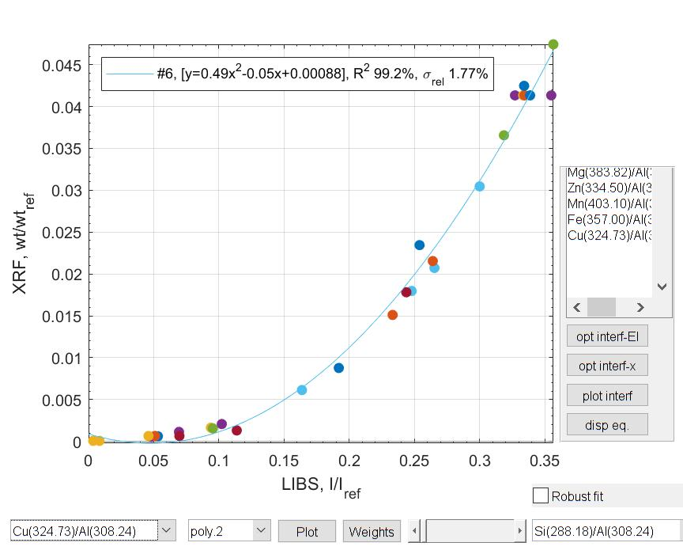
Cu 324,73 / Al 308,24
Reference intensity: >1000 cts
Reference intensity: >5000 cts

